Slide 1
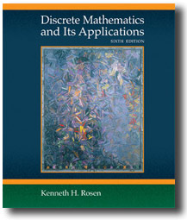
Chapter 7 Images
Discrete Mathematics
and Its Applications
Sixth Edition
By Kenneth Rosen
Copyright © The McGraw-Hill Companies, Inc. Permission required for reproduction or display.

Slide 2
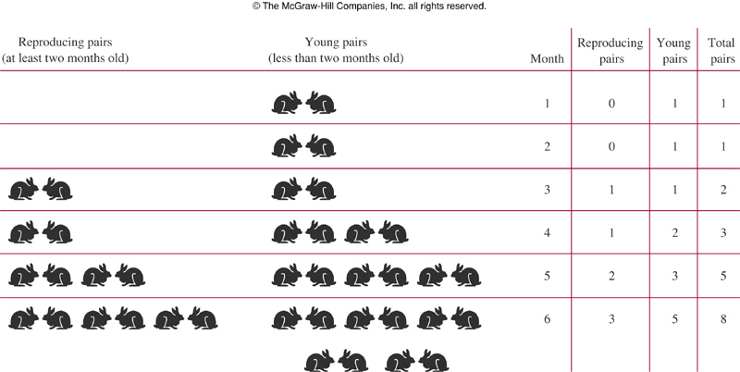
07_1_01.jpg
Notes:
p:\msoffice\My Projects\Rosen 6e 2007\Imagebank\JPEGs07-24-06\ch07\jpeg\07_1_01.jpg

Slide 3
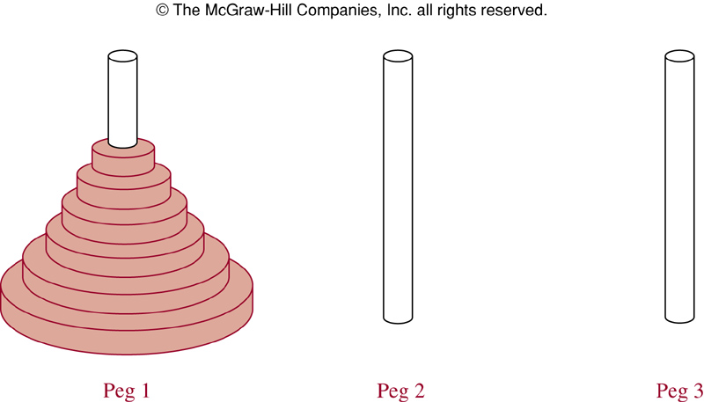
07_1_02.jpg
Notes:
p:\msoffice\My Projects\Rosen 6e 2007\Imagebank\JPEGs07-24-06\ch07\jpeg\07_1_02.jpg

Slide 4
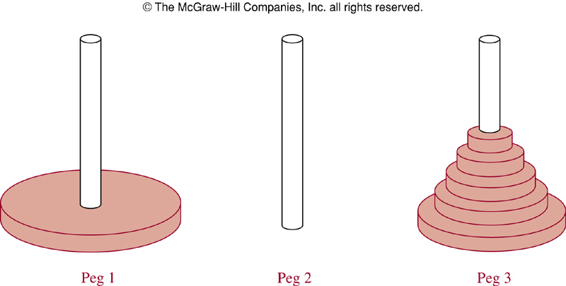
07_1_03.jpg
Notes:
p:\msoffice\My Projects\Rosen 6e 2007\Imagebank\JPEGs07-24-06\ch07\jpeg\07_1_03.jpg

Slide 5
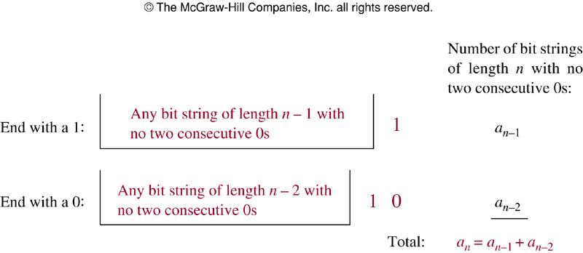
07_1_04.jpg
Notes:
p:\msoffice\My Projects\Rosen 6e 2007\Imagebank\JPEGs07-24-06\ch07\jpeg\07_1_04.jpg

Slide 6
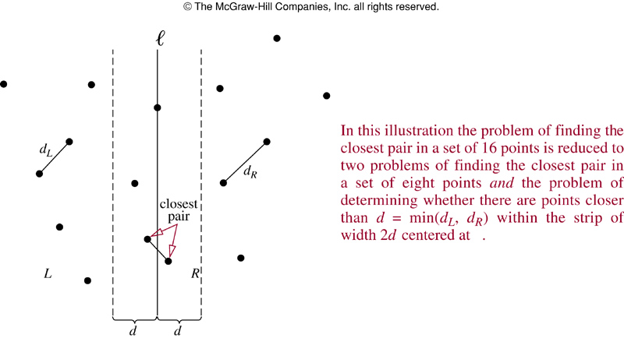
07_3_01.jpg
Notes:
p:\msoffice\My Projects\Rosen 6e 2007\Imagebank\JPEGs07-24-06\ch07\jpeg\07_3_01.jpg

Slide 7
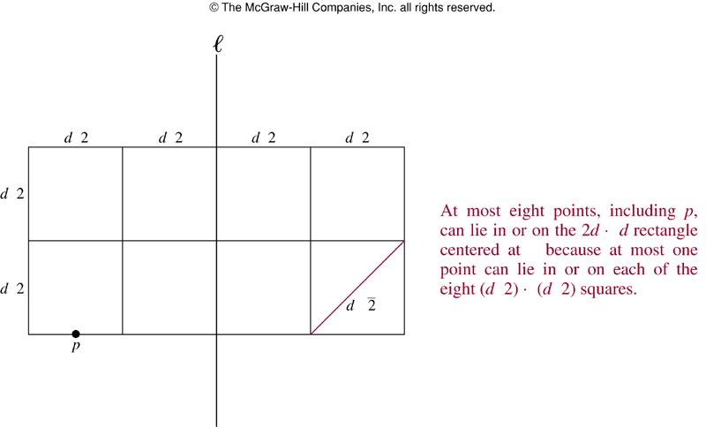
07_3_02.jpg
Notes:
p:\msoffice\My Projects\Rosen 6e 2007\Imagebank\JPEGs07-24-06\ch07\jpeg\07_3_02.jpg

Slide 8
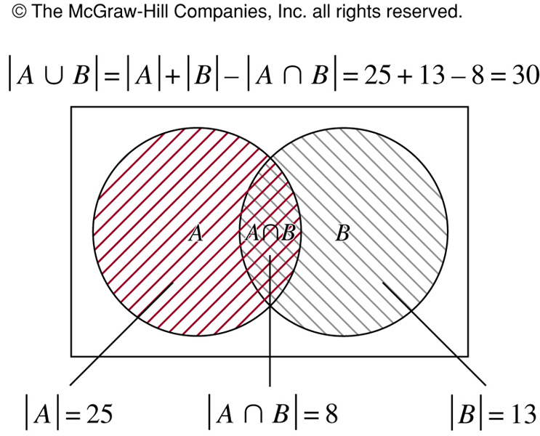
07_5_01.jpg
Notes:
p:\msoffice\My Projects\Rosen 6e 2007\Imagebank\JPEGs07-24-06\ch07\jpeg\07_5_01.jpg

Slide 9
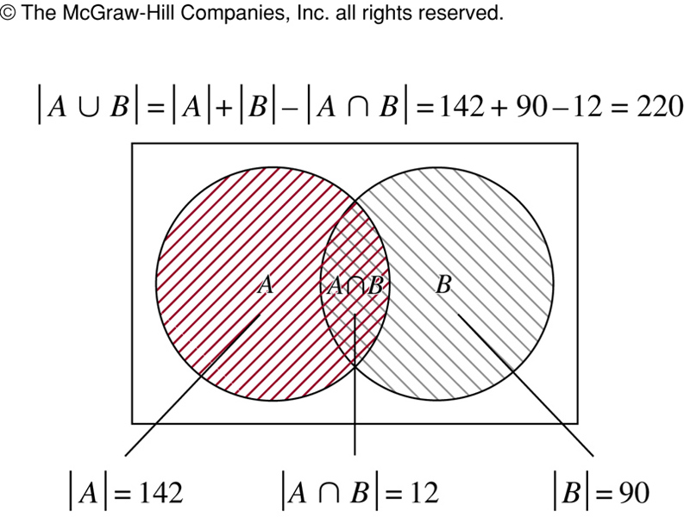
07_5_02.jpg
Notes:
p:\msoffice\My Projects\Rosen 6e 2007\Imagebank\JPEGs07-24-06\ch07\jpeg\07_5_02.jpg

Slide 10
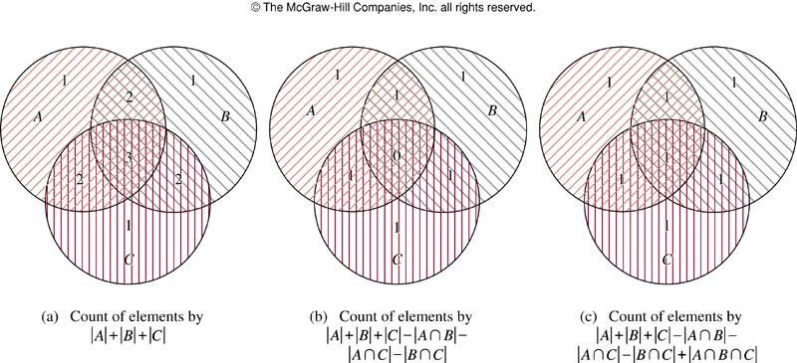
07_5_03.jpg
Notes:
p:\msoffice\My Projects\Rosen 6e 2007\Imagebank\JPEGs07-24-06\ch07\jpeg\07_5_03.jpg

Slide 11
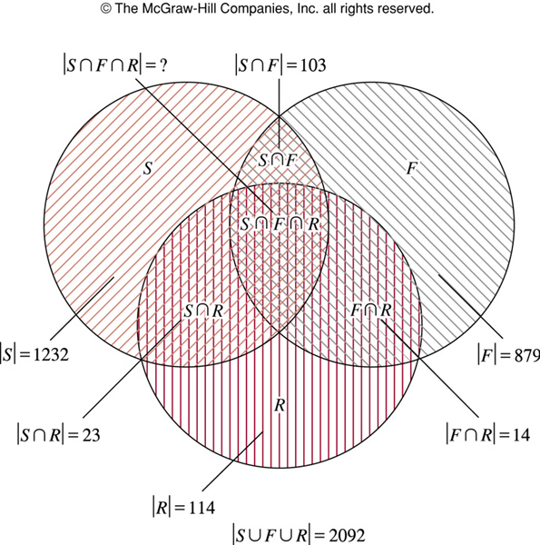
07_5_04.jpg
Notes:
p:\msoffice\My Projects\Rosen 6e 2007\Imagebank\JPEGs07-24-06\ch07\jpeg\07_5_04.jpg

Slide 12
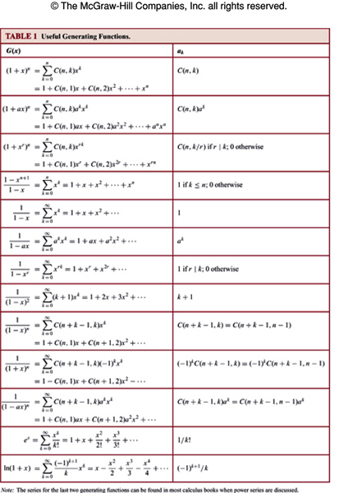
t07_4_01.jpg
Notes:
p:\msoffice\My Projects\Rosen 6e 2007\Imagebank\JPEGs07-24-06\ch07\jpeg\t07_4_01.jpg

Slide 13
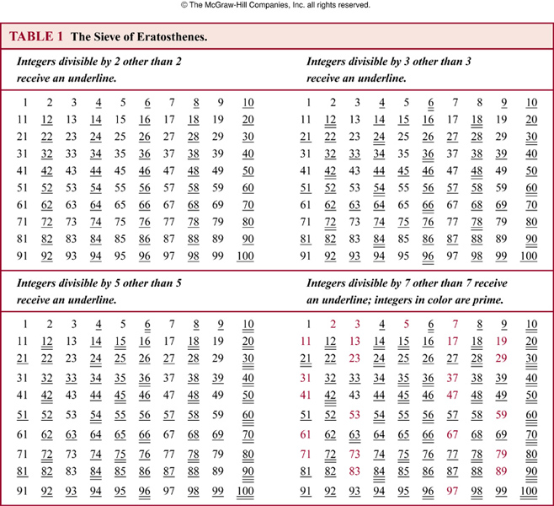
t07_6_01.jpg
Notes:
p:\msoffice\My Projects\Rosen 6e 2007\Imagebank\JPEGs07-24-06\ch07\jpeg\t07_6_01.jpg

Slide 14
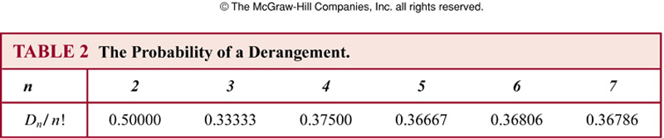
t07_6_02.jpg
Notes:
p:\msoffice\My Projects\Rosen 6e 2007\Imagebank\JPEGs07-24-06\ch07\jpeg\t07_6_02.jpg

